Slide 1
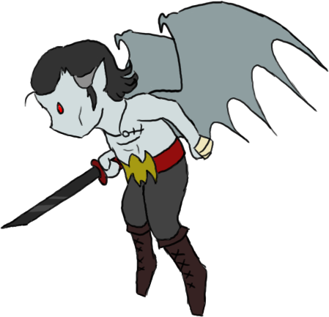
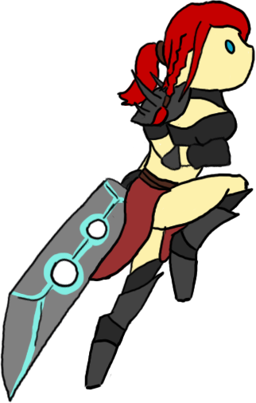
Scarlet: A Tale Untold
A short video game by team 7
© FaultyTeabag Co.

Slide 2
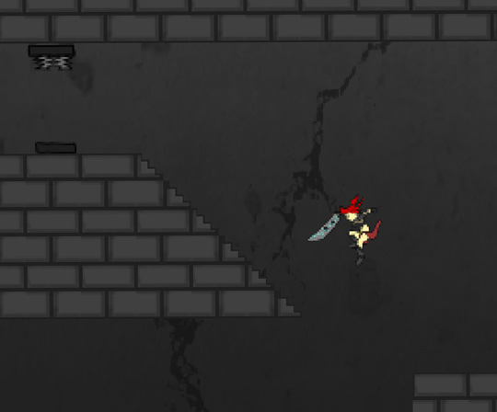
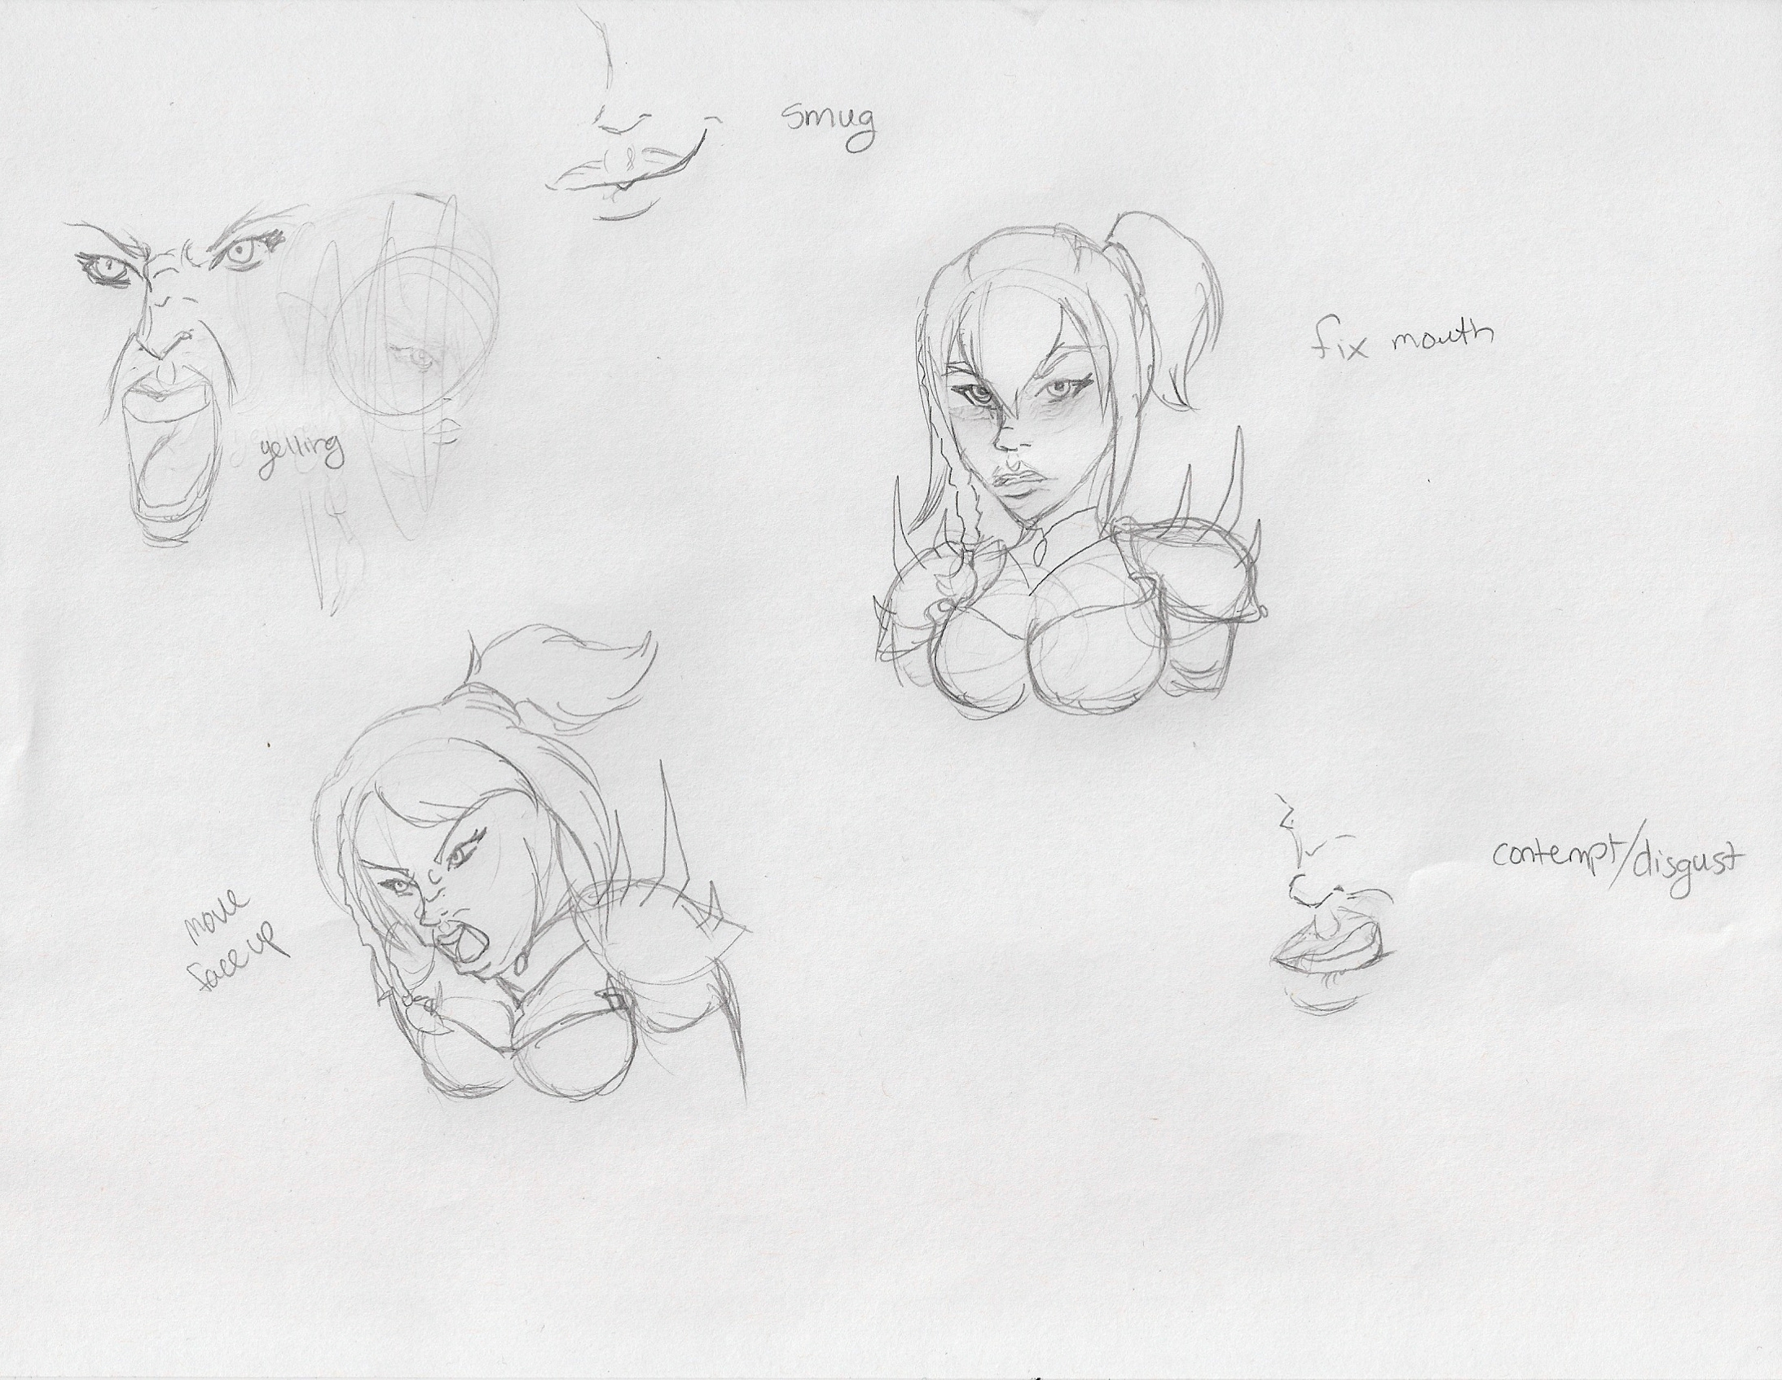
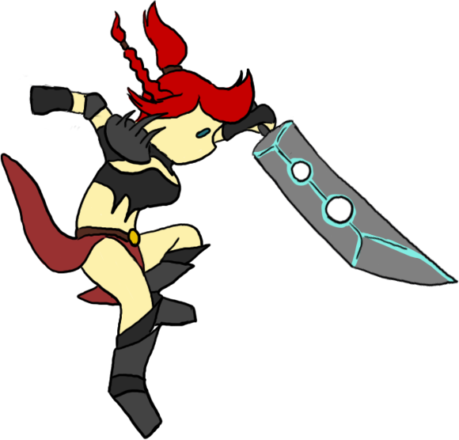

Initial Idea
A multi-level, 2D platformer game
An idea similar to that of Megaman and Super Metroid, but with a unique concept and story
A game based roughly in 14th Century Transylvania, consisting of about 3 or 4 levels, each with their own boss/mini boss
An extra feature, would have been some RPG aspects, such as various weapons, leveling the character, extra dialogue, etc.

Slide 3
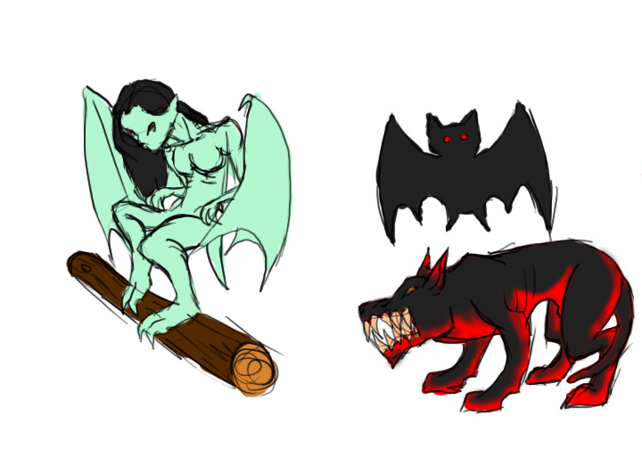

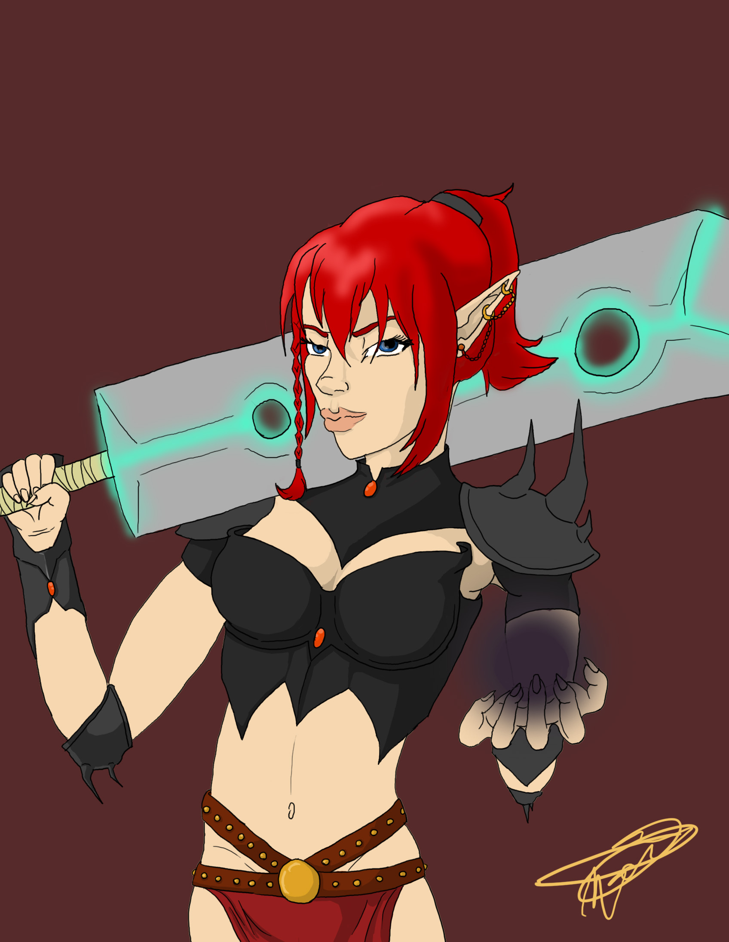
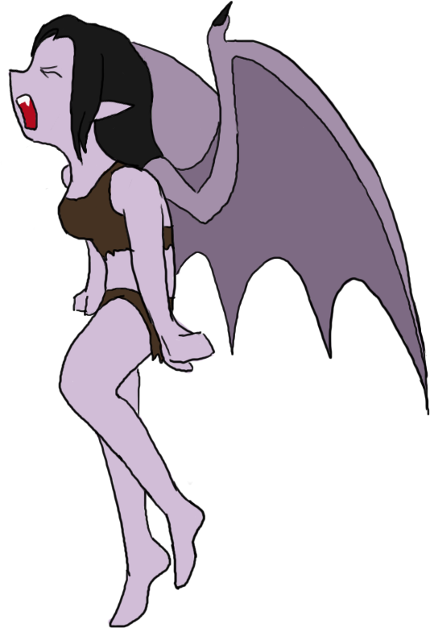
Developing the Idea
Came up with the story and history of the protagonist
Scarlet is the child of Dracul Darien (vampire lord)
Created concept art for characters and monsters
Dialogue was brainstormed
Gamemaker mechanisms were worked out for game play
After seeing how much work was needed for one level, the size/length of game was cut down

Slide 4
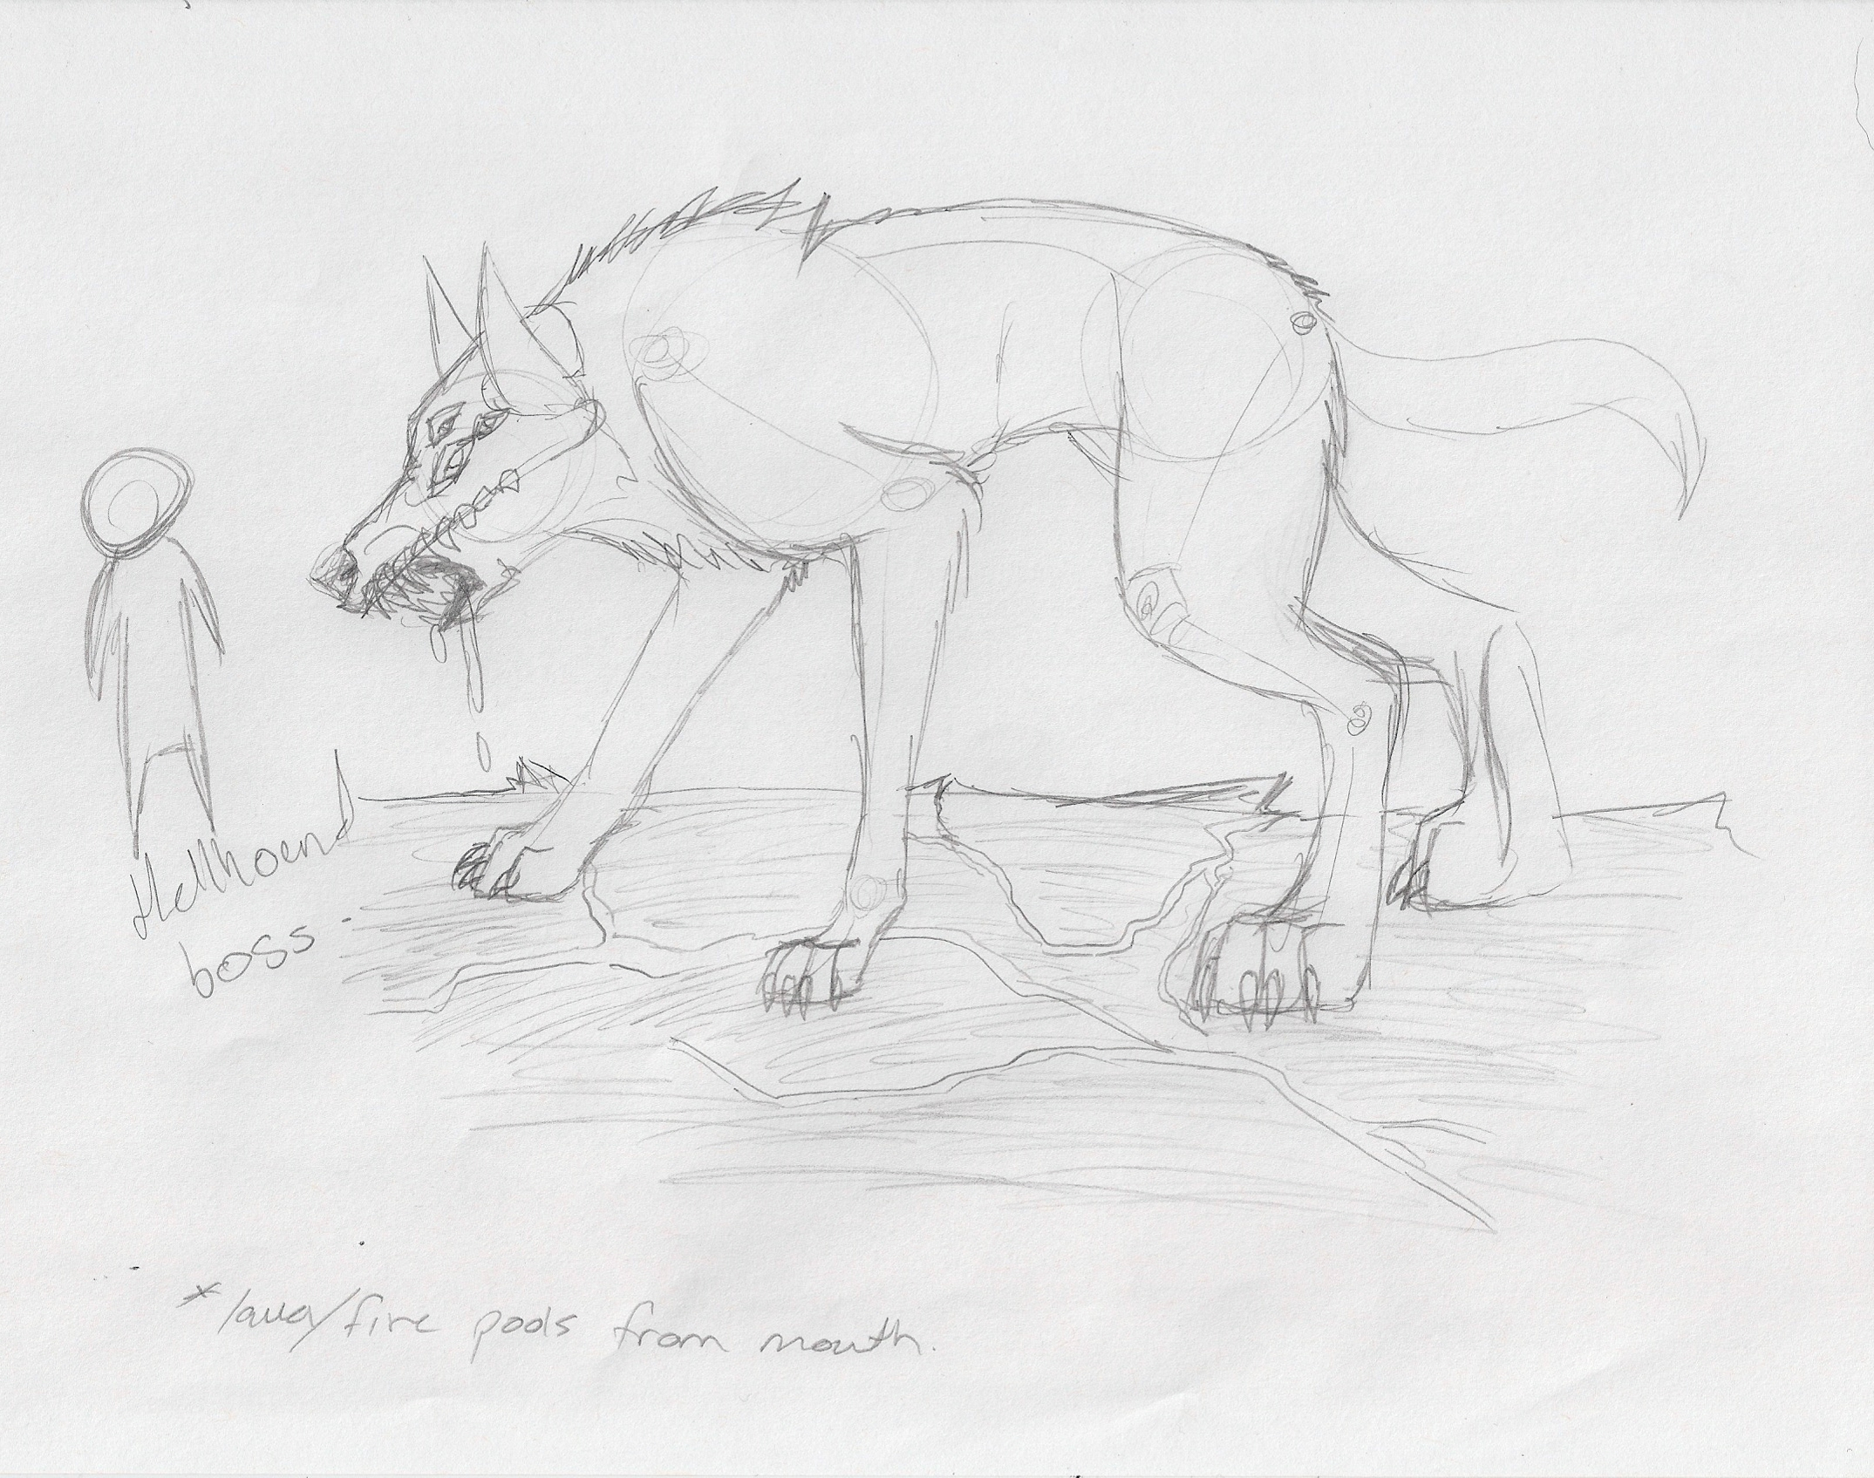
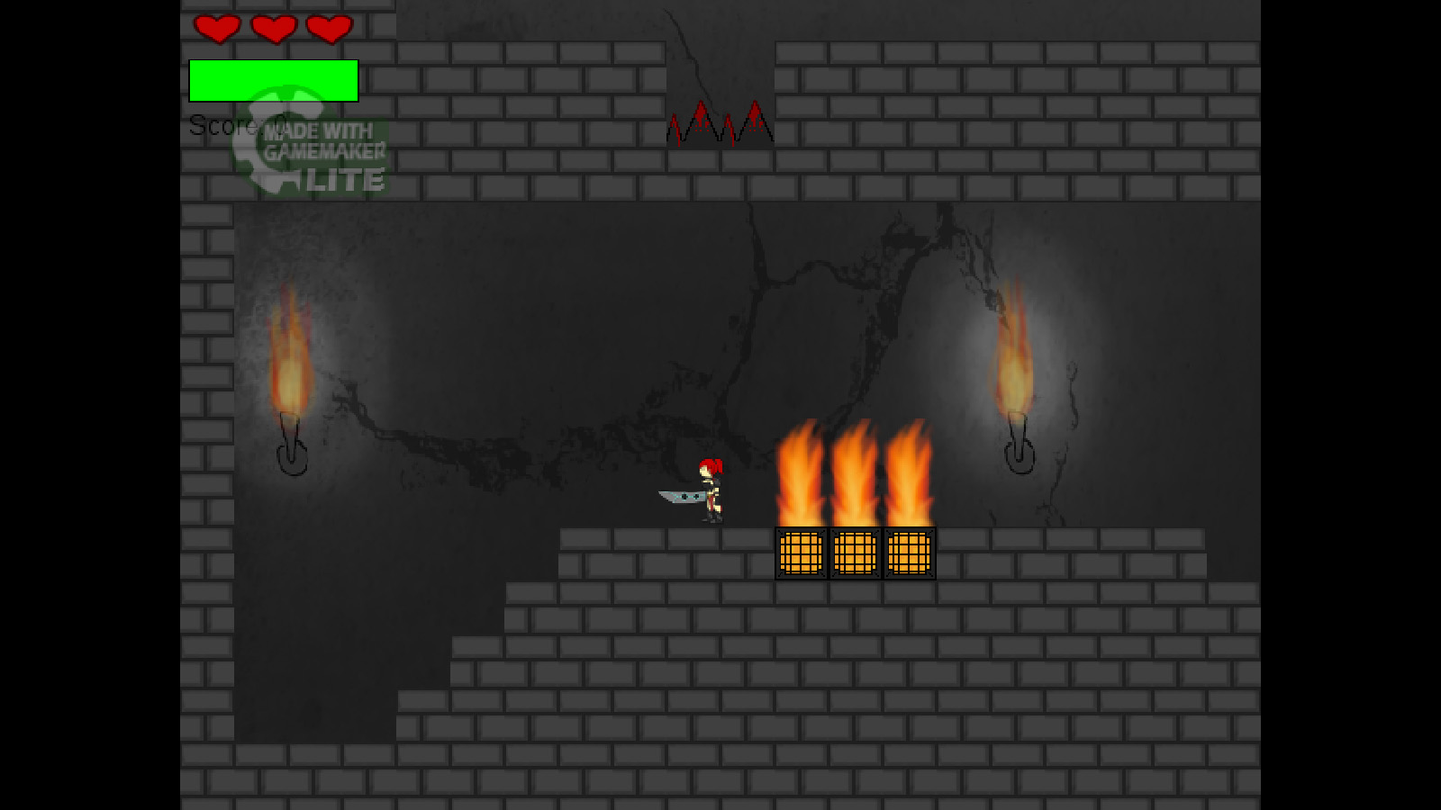
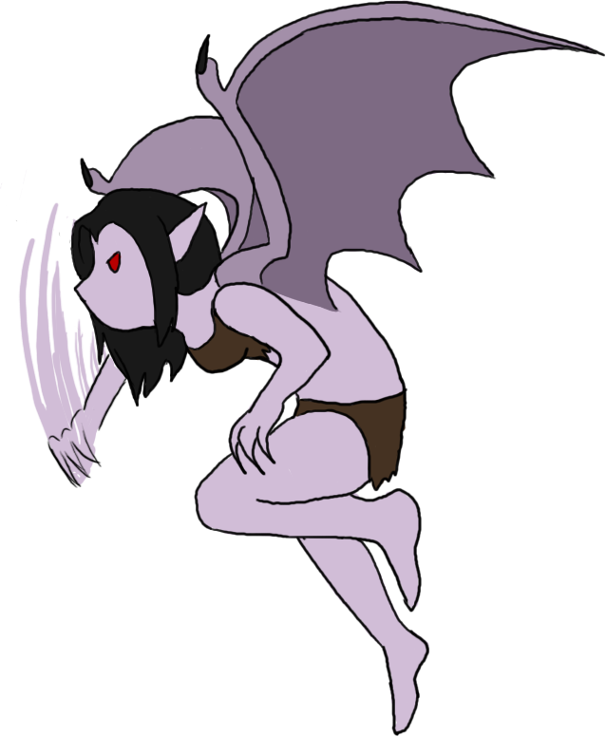
Final Game
Many levels were exluded
Forest
Mountains/cave
Swamp
Decided to have the main idea and focus on the main storyline
Ideally would carry on developing game, to include the above levels
Their own monsters and boses

Slide 5
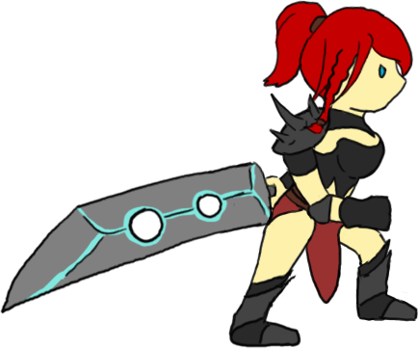
Demonstration
To Follow

